Slide 1
Acts 8:-18
And Saul was there, giving approval to his death.
On that day a great persecution broke out against the church at Jerusalem, and all except the apostles were scattered throughout Judea and Samaria. ²Godly men buried Stephen and mourned deeply for him. ³But Saul began to destroy the church. Going from house to house, he dragged off men and women and put them in prison.

Slide 2
Acts 8:-18
⁴Those who had been scattered preached the word wherever they went.
⁵Philip went down to a city in Samaria and proclaimed the Christ there. ⁶When the crowds heard Philip and saw the miraculous signs he did, they all paid close attention to what he said. ⁷With shrieks, evil spirits came out of many, and many paralytics and cripples were healed.
⁸So there was great joy in that city.

Slide 3
The Early Church Matures
Mission and Growth
June 5th - Greg Mellow

Slide 4
Mission and Growth
Acts:8:5-41
“from Jerusalem to Rome”
Summary: Philip crossed the social barriers.
Good News: in Jesus, reconciliation with God, and reconciliation between people.

Slide 5
Mission and Growth
Acts/Acts:8:5-40
Luke-Acts
two volumes, one story,
~30 years from 30 AD to 60 AD.
Over 25% of the New Testament
Author: Luke,
a medical doctor, co-worker with Paul, probably ‘Hellenistic’ (Greek) in culture,
educated writer, well travelled

Slide 6
Mission and Growth
Acts/Acts:8:5-40
Luke-Acts
Purpose: historical account,
politics (faith v the Empire)
evangelism
Summary: Luke “to Jerusalem”
Acts “from Jerusalem to Rome”

Slide 7
Mission and Growth
Acts:8:5-41
“from Jerusalem to Rome”
~ 2500 Km
Melbourne to Townsville
Melbourne to Kalgoorlie
Melbourne to New Zealand (South Island)

Slide 8
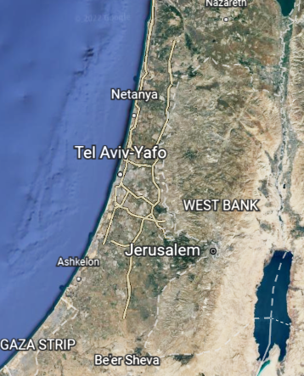
Mission and Growth
Acts:8:5-41
“from Jerusalem to Rome”
Samaritans
Different heritage – but similar
Different religion – but similar
History of animosity
100 Km, 4 days walk

Slide 9
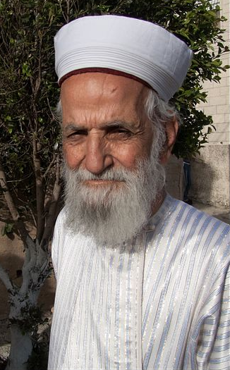
Mission and Growth
Acts:8:5-41
“from Jerusalem to Rome”
Samaritans
Different heritage – but similar
Different religion – but similar
History of animosity
100 Km, 4 days walk

Slide 10
Mission and Growth
Acts:8:5-41
“from Jerusalem to Rome”
Samaritans
Different heritage – but similar
Different religion – but similar
History of animosity
…many people believed Philip’s message of Good News concerning the Kingdom of God and the name of Jesus Christ…

Slide 11
Mission and Growth
Acts:8:5-41
“from Jerusalem to Rome”
Samaritans
Philip took the message of grace to his ‘enemies’.
What about me?
Do I hold a grudge,
or have hate, or distain for anyone?
What about us…?

Slide 12
Mission and Growth
Acts:8:5-41
“from Jerusalem to Rome”
The Ethiopian Eunuch
Different race
Different ethnicity & nationality
Minority sexual status
Different social status
Same religion?
‘End of the earth’ location

Slide 13
Mission and Growth
Acts:8:5-41
“from Jerusalem to Rome”
The Ethiopian Eunuch
Different race
Different ethnicity & nationality
Minority sexual status
Different social status
Same religion?
‘End of the earth’ location

Slide 14
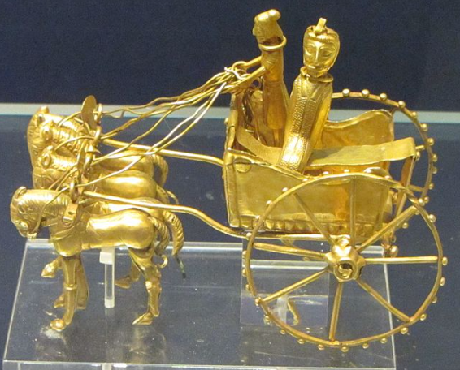
Mission and Growth
Acts:8:5-41
“from Jerusalem to Rome”
The Ethiopian Eunuch
Different race
Different ethnicity
Minority sexual status
Different social status
Same religion?
‘End of the earth’ location

Slide 15
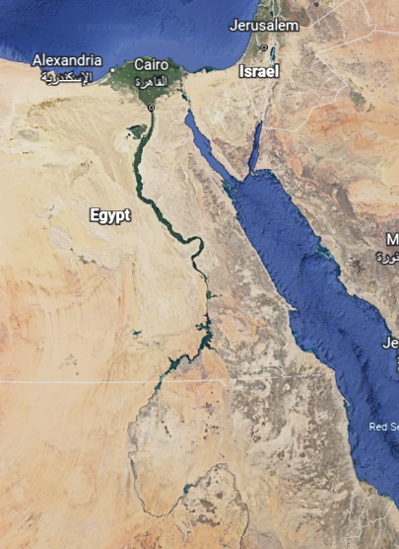
Mission and Growth
Acts:8:5-41
“from Jerusalem to Rome”
The Ethiopian Eunuch
Different race
Different ethnicity
Minority sexual status
Different social status
Same religion?
‘End of the earth’ location

Slide 16
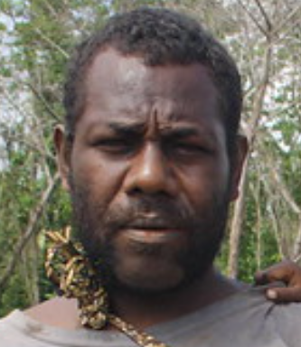
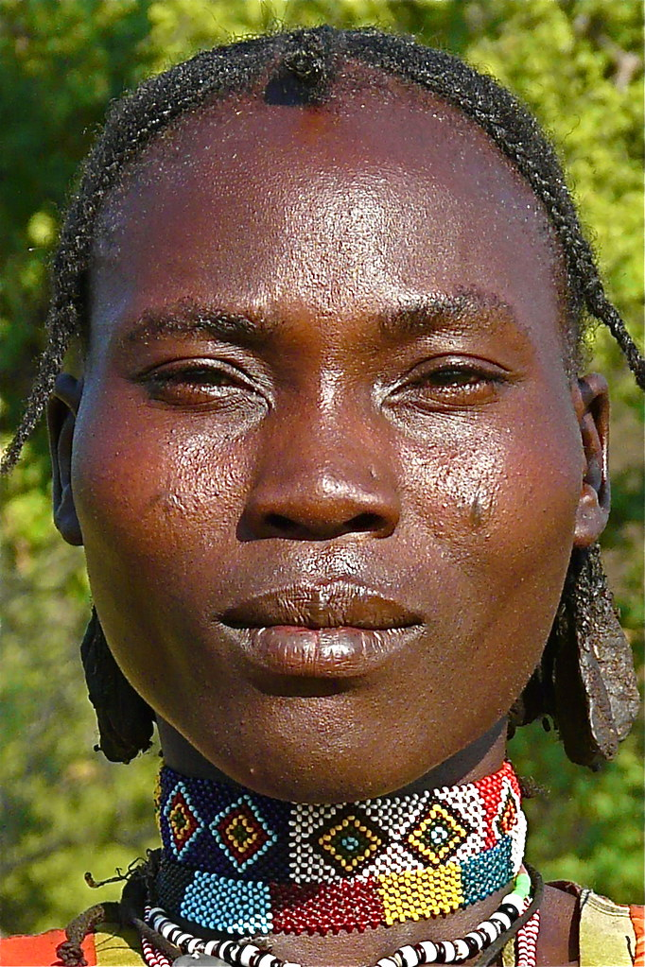
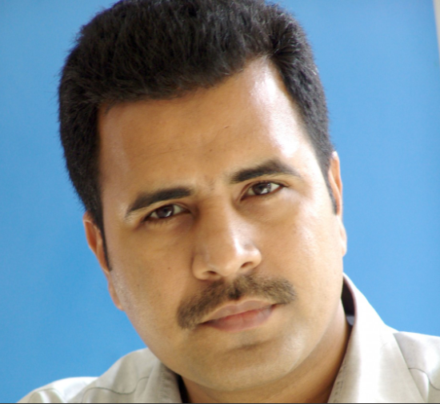
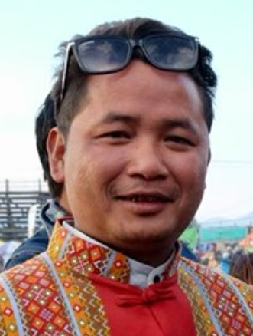
Mission and Growth
Acts:8:5-41
“from Jerusalem to Rome”
The Ethiopian Eunuch
Philip took the message of grace someone who was different.
What about me?
Do I relate across cultures?
What about us …

Slide 17
Mission and Growth
Acts:8:5-41
“from Jerusalem to Rome”
Grid
Group
Bureaucratic | Corporate
Individualist | Collectivist

Slide 18
Mission and Growth
Acts:8:5-41
“from Jerusalem to Rome”
Summary:
Philip crossed the social barriers.
Do I have hate, or distain?
Do I cross the social barriers?
Good News:
in Jesus there is reconciliation with God, and hopefully, reconciliation between people.

Slide 19
The Early Church Matures
Mission and Growth
June 12th - Tony Lyon

Slide 20
The Early Church Matures
Mission and Growth
June 19th - Denise Hyland

Slide 21
The Early Church Matures
Mission and Growth
June 26th - Elisa Dickenson

